Slide 1

 Thursday, July 8th, 2021
 Salt Mine Productive Workspace

Slide 2


Today’s speakers
Sheng Slogar
Founder, Diglactic

Slide 3
agenda
6:40 P | • | Pizza & Networking
7:00 P | • | Laravel Performance Pitfalls Sheng Slogar
7:30 P | • | Open Mic / Lightning Talks Anyone
7:50 P | • | Q & A
7:55 P | • | Wrap Up

Slide 4

Performance Pitfalls 📛
Things to look out for. Patterns to avoid. Memes.
Notes:
Quick and dirty rundown of things I’ve learned over the years of working with Laravel

Slide 5
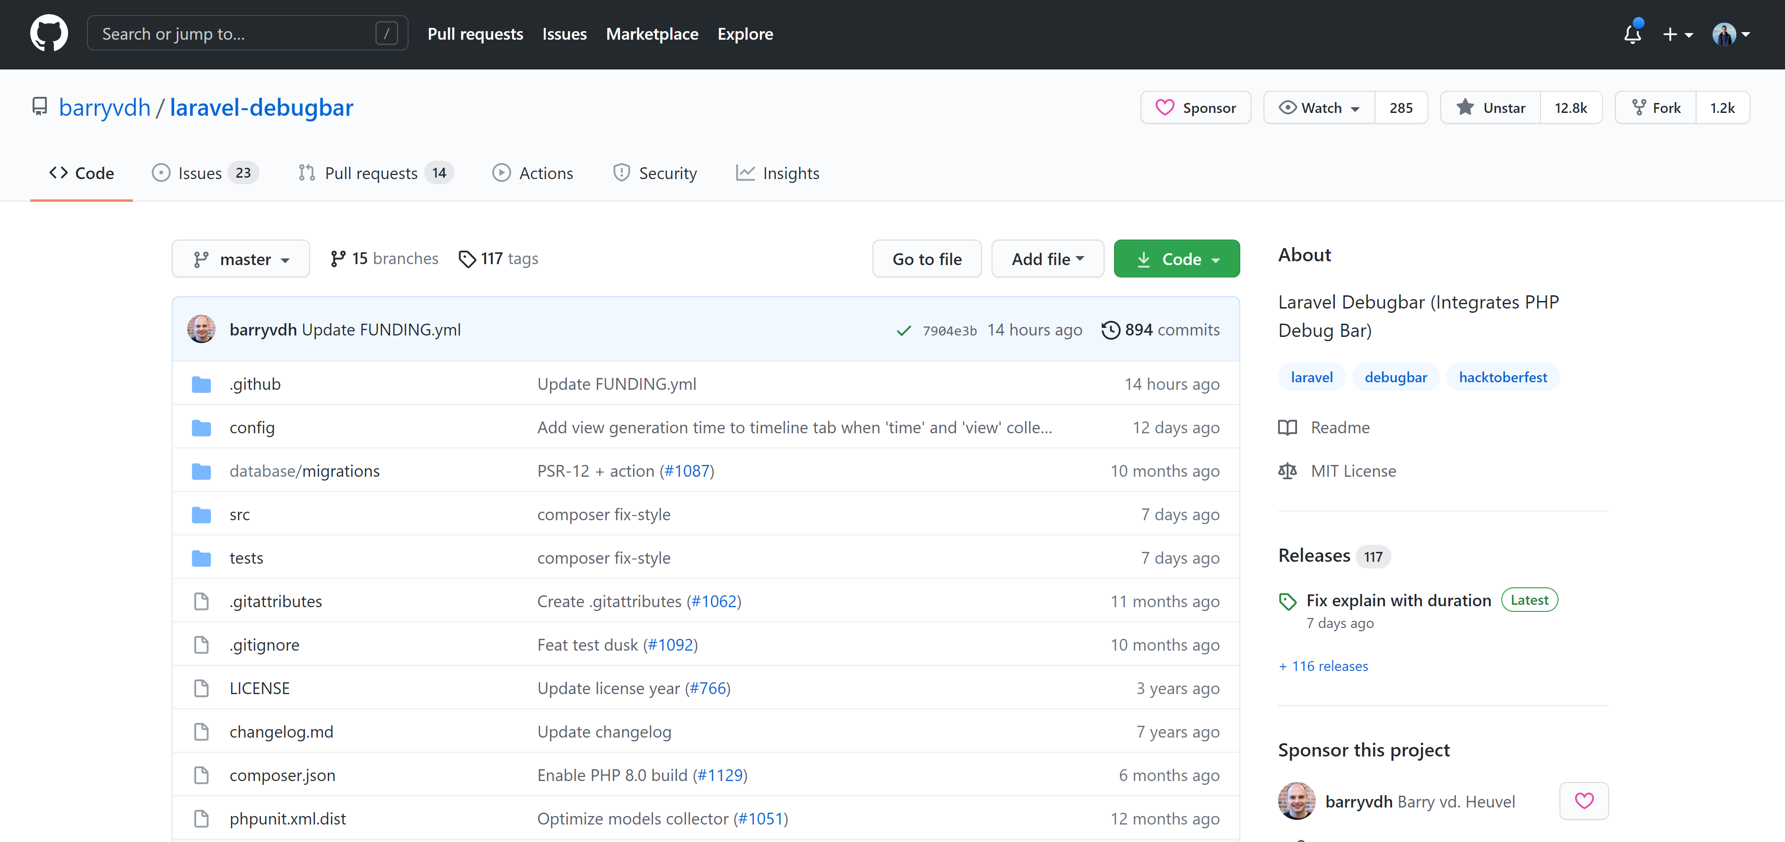
Laravel Debugbar
composer require barryvdh/laravel-debugbar --dev
Notes:
You’ve all probably used this before, but here’s a quick rundown.
When we want to optimize our application, this is the best place to start.
Not included with Laravel by default.

Slide 6
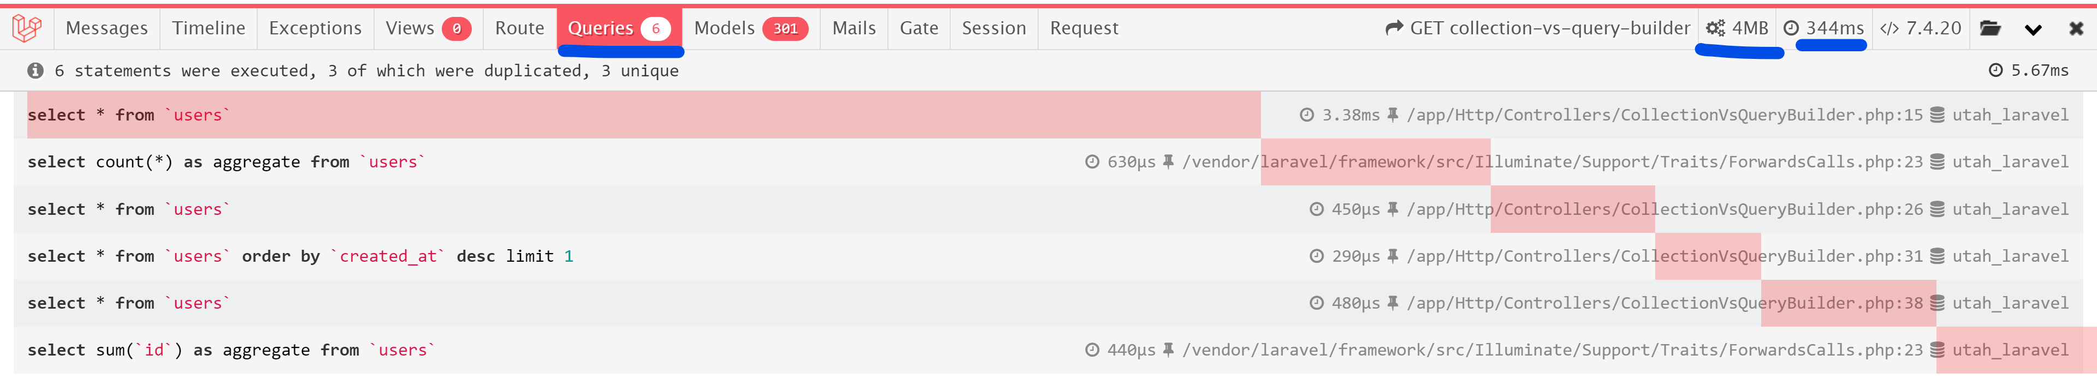
DebugBar Primer
Start here:
Database query count and long-running queries
Script memory usage
Script execution time
Notes:
This will vary based on your PHP version, but by default, PHP scripts are limited to 128M of RAM.
Database query count; I’m currently working on a project that has an INSANE amount of database queries and is causing the app to crash.

Slide 7
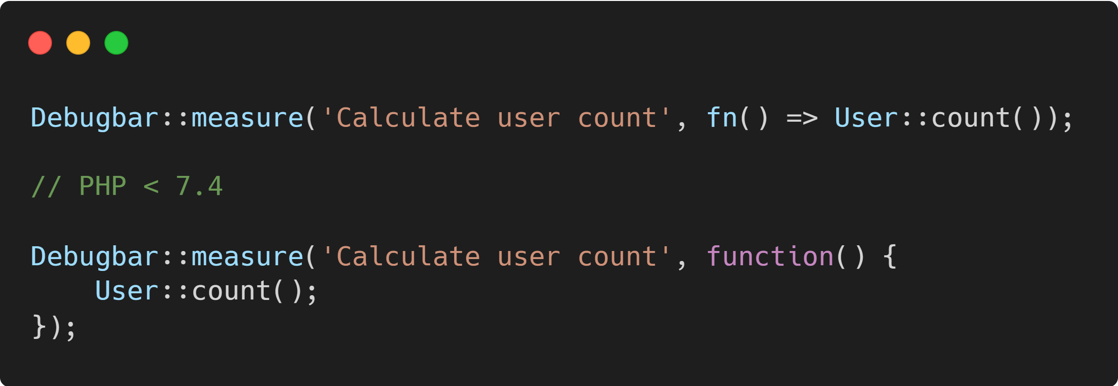
Measuring Execution Time
If you want to track how long a specific method is taking to execute, use Debugbar::measure. This will show up under the timeline tab in a waterfall view.
Notes:
An easy way to calculate execution time that I was unaware of.

Slide 8

Agree to Continue
You won’t see time metrics on the next slides. Run your own benchmarks.
Notes:
Disclaimer: I’m not going to break down everything in the following slides. Use at your own risk. Run benchmarks in your own apps.

Slide 9
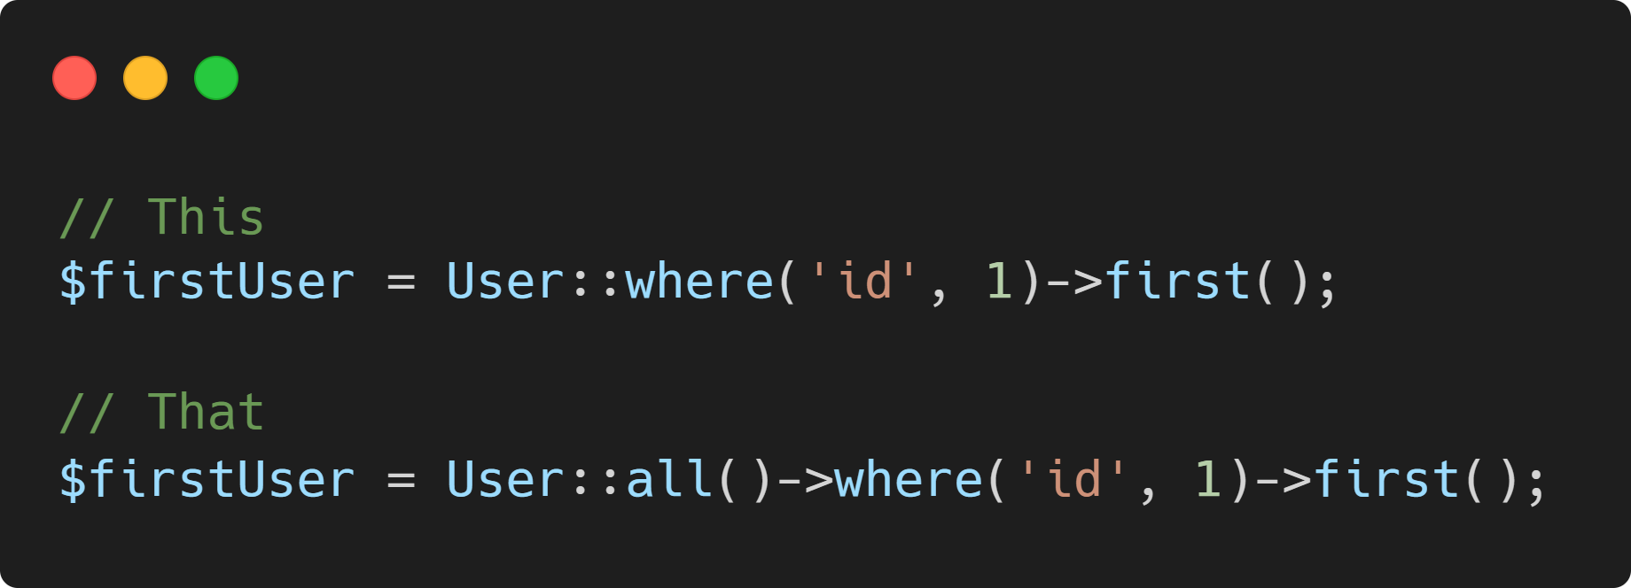
Collections vs. query builder
Collections and the database query builder share very similar method names.
Worse, the query builder returns collections, muddying the water.
Notes:
Collections AND the query builder are my favorite part of Laravel.
BUT, I constantly see people misusing or abusing them, and it’s something worth reviewing.
Let’s review pitfall #1.

Slide 10

Method Mixup
Same name, same functionality:
first
where
max
min
count
sum
Different name, same functionality:
Collection::random Builder::inRandomOrder
Collection::sortBy Builder::orderBy
Collection::isEmpty Builder::exists
Collection::take Builder::limit
Notes:
Here’s a quick comparison of how easy it is to mix up collections and query builder methods
(In other words, PHP vs database driver)

Slide 11

Wait ✋
Why does this matter?
PHP is not a database
Use the tool built for the job
Key takeaway: leverage the Laravel query builder instead of collections whenever possible

Slide 12

Show Me the Code

Slide 13
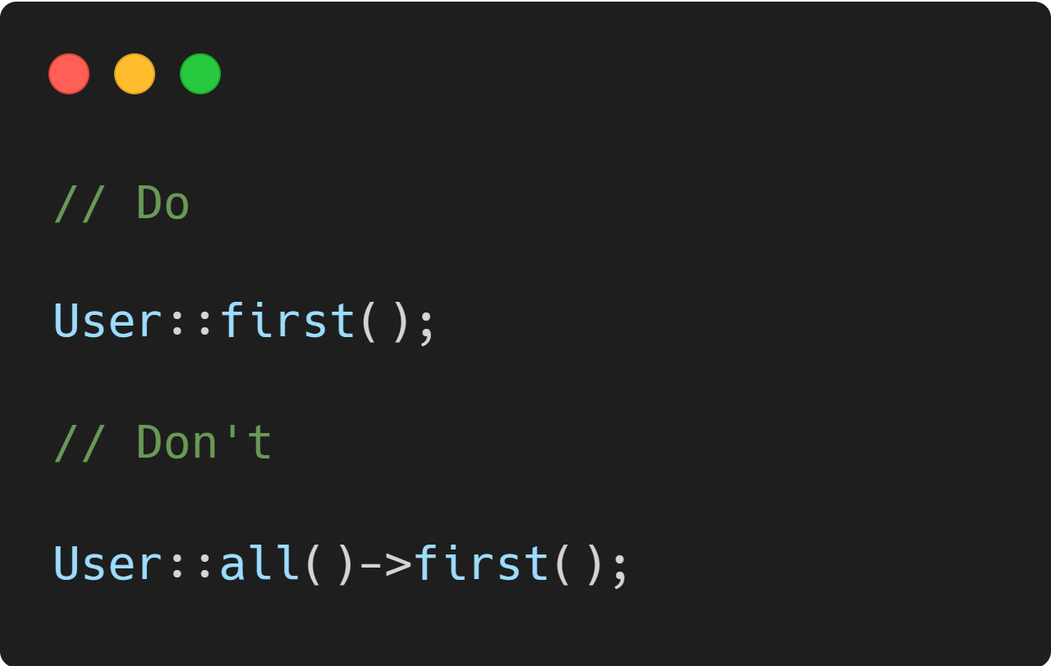
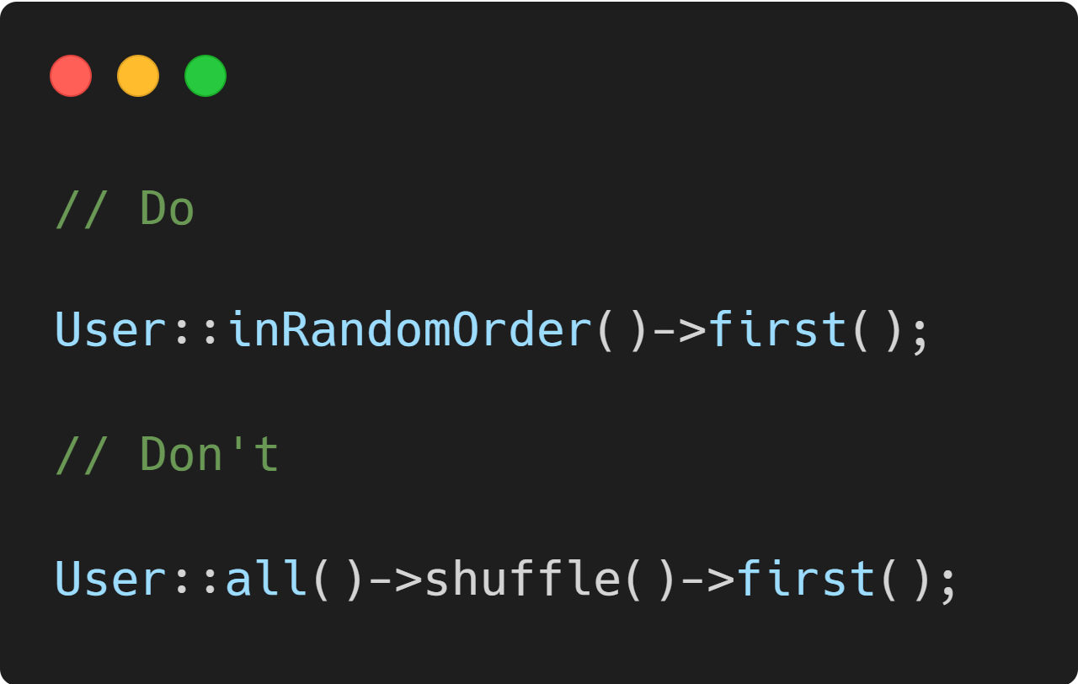
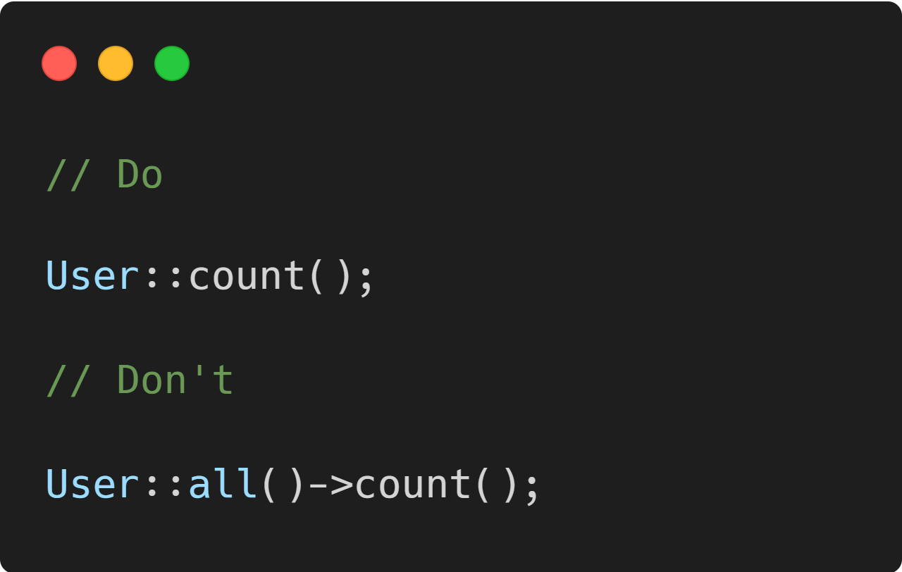
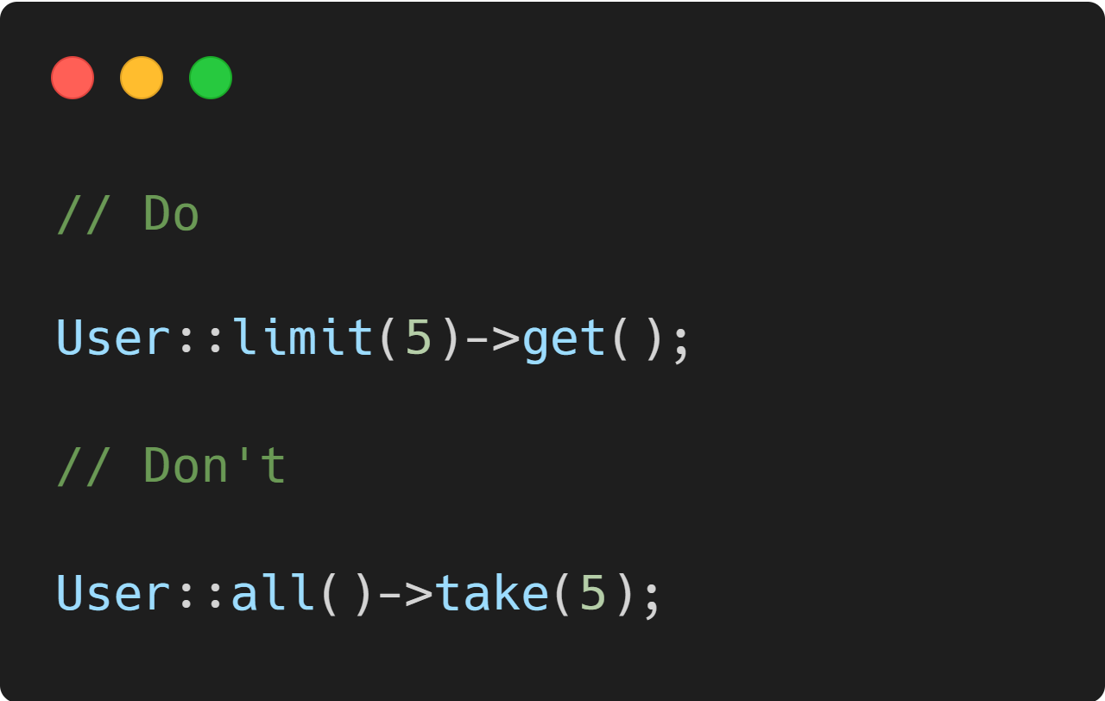
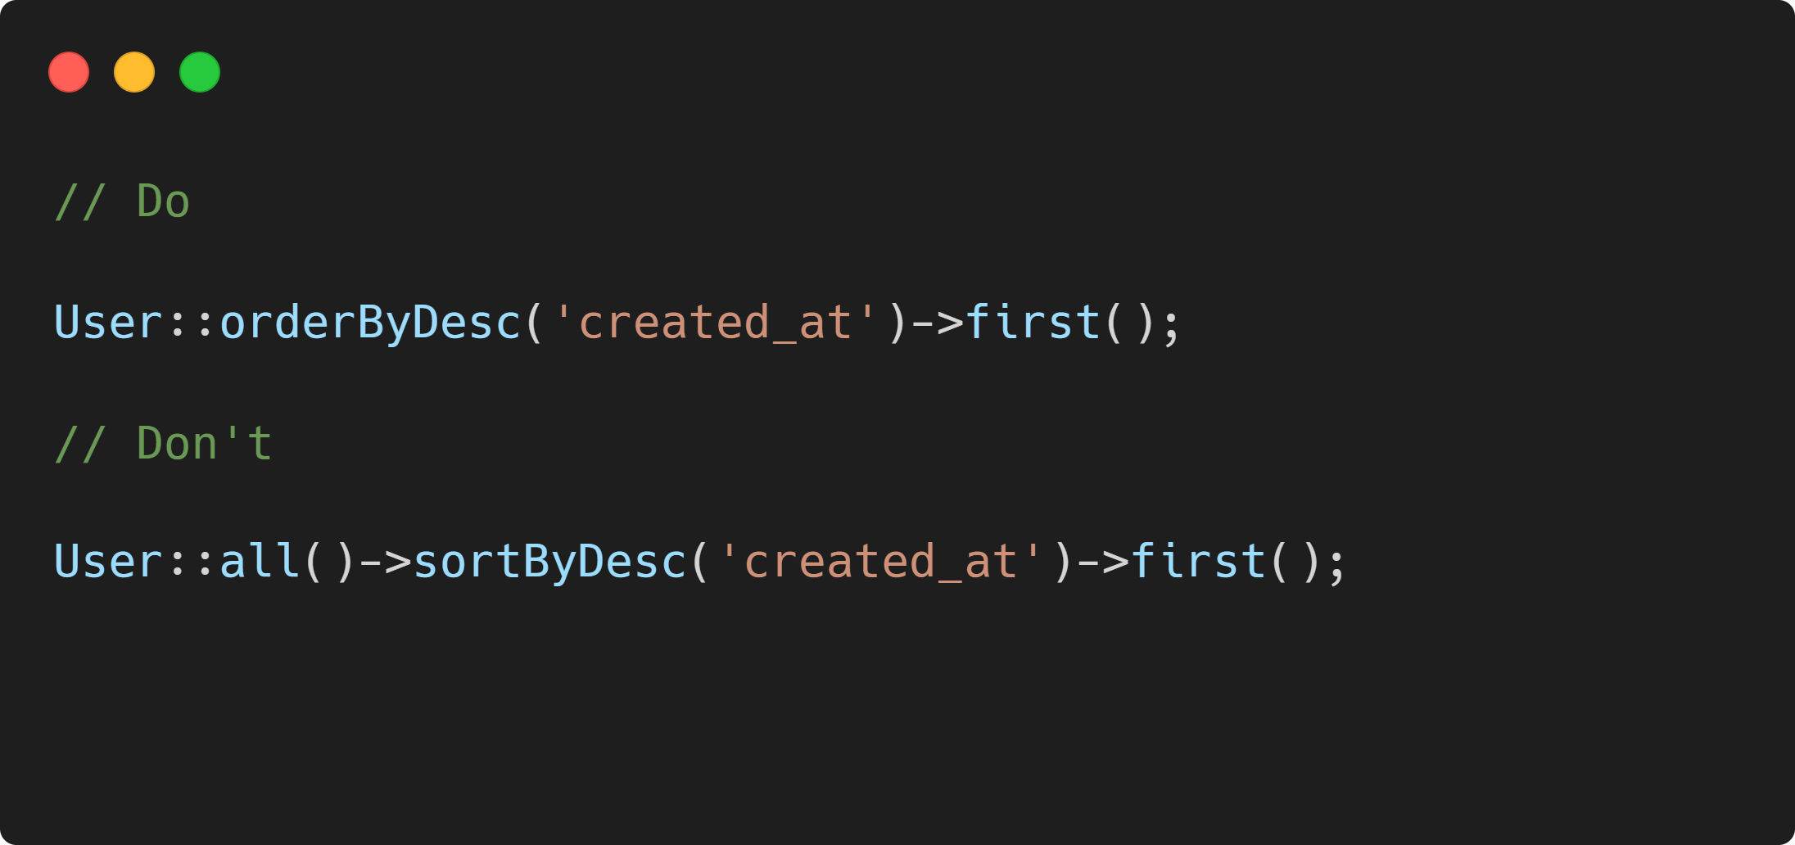

Slide 14

Notice a pattern?
Notes:
Build your query, then get your data.
Don’t get your data only to filter it later.

Slide 15
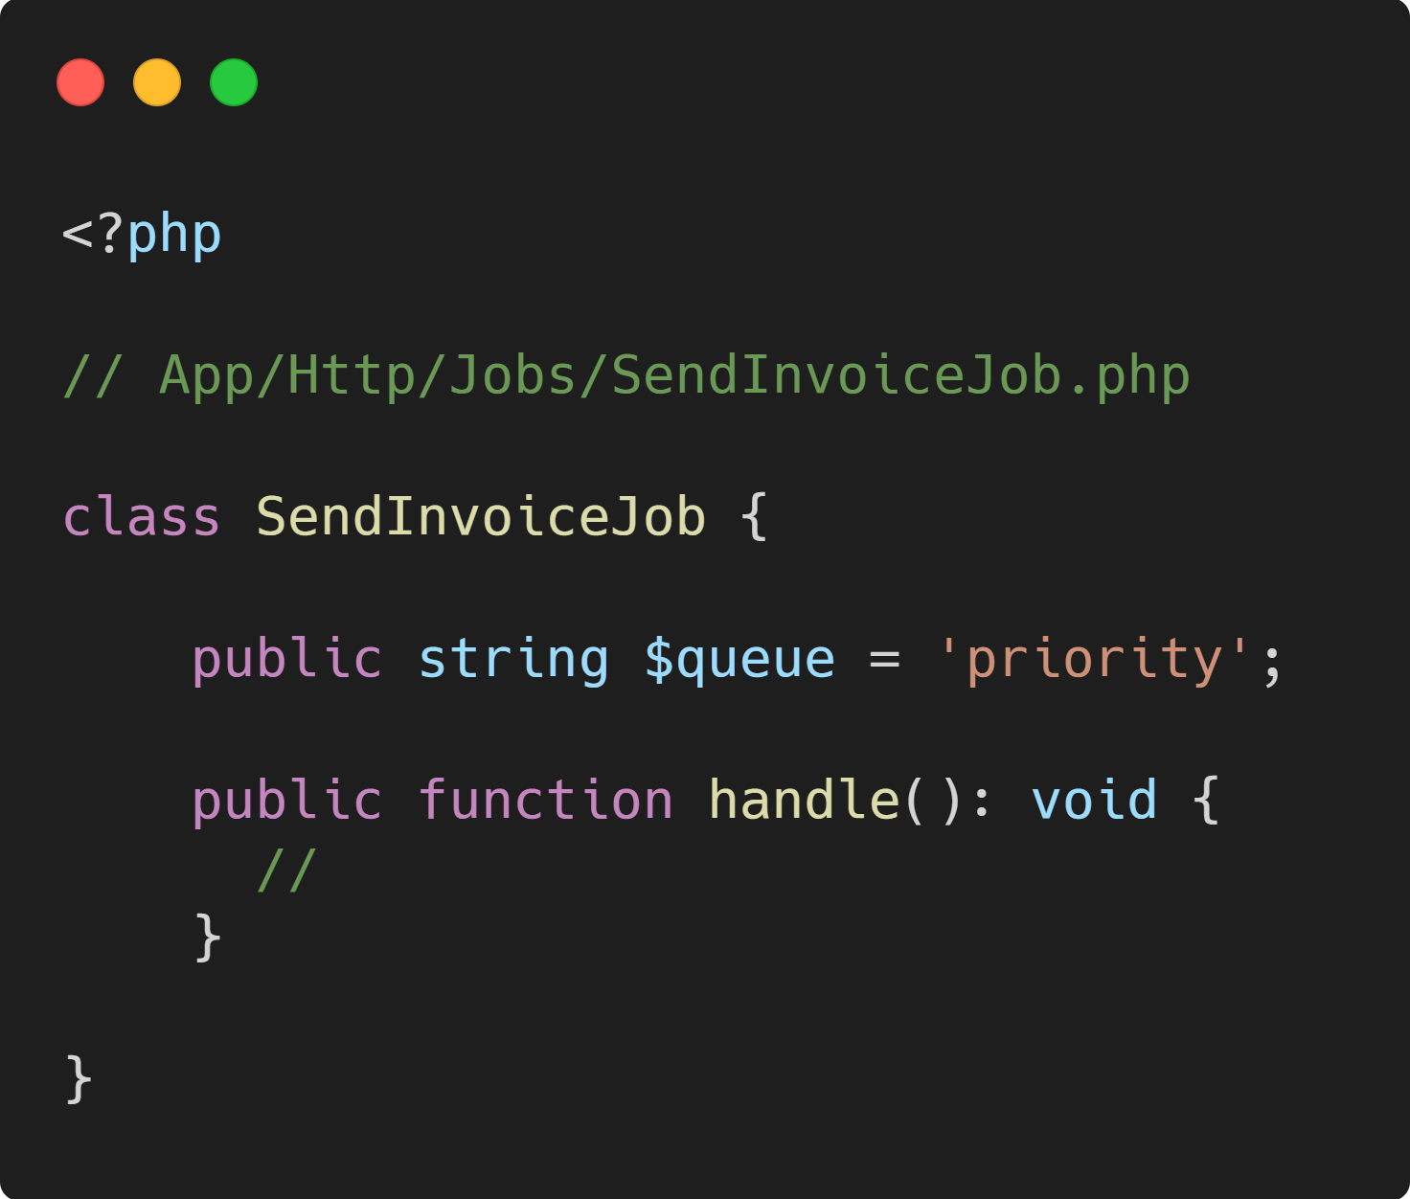
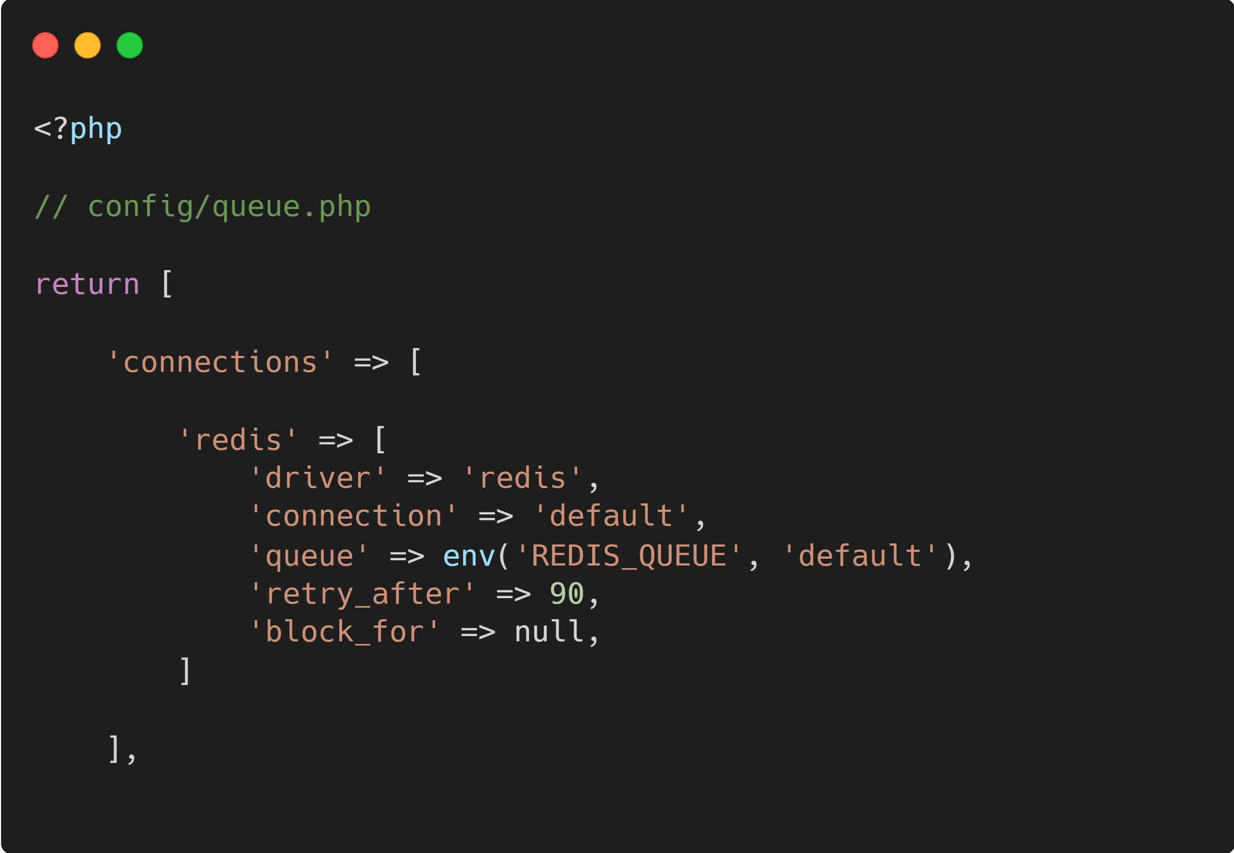
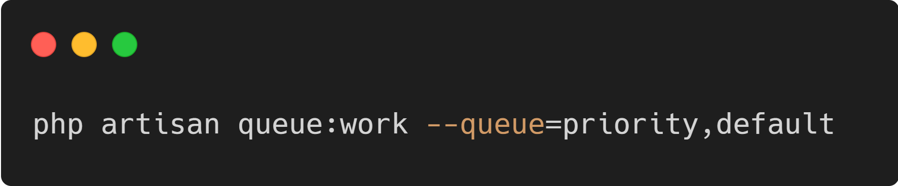
queues! And priority queues.
Queue up tasks that don’t need to be processed synchronously. Don’t block the user thread.
Prioritize queues by name. When running php artisan queue:work, queues are prioritized in order.
Notes:
Note that connections.redis.queue refers to the Redis queue name, not the Laravel queue name, which is specified with the queue:work --queue= argument.

Slide 16
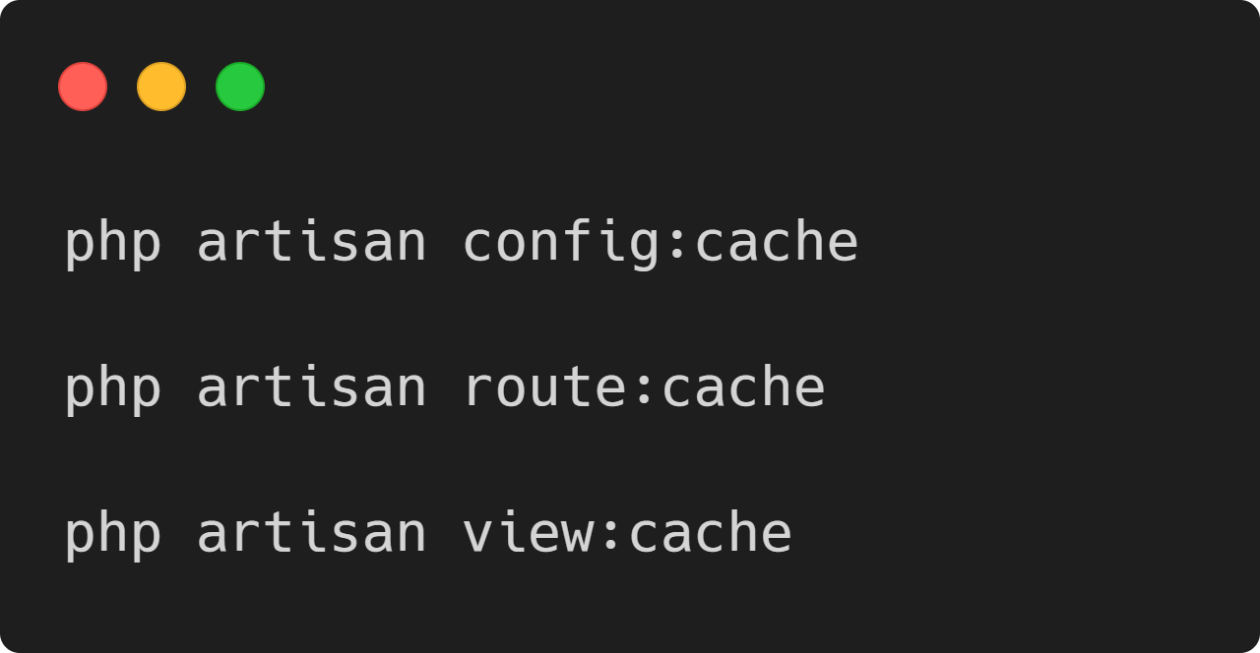
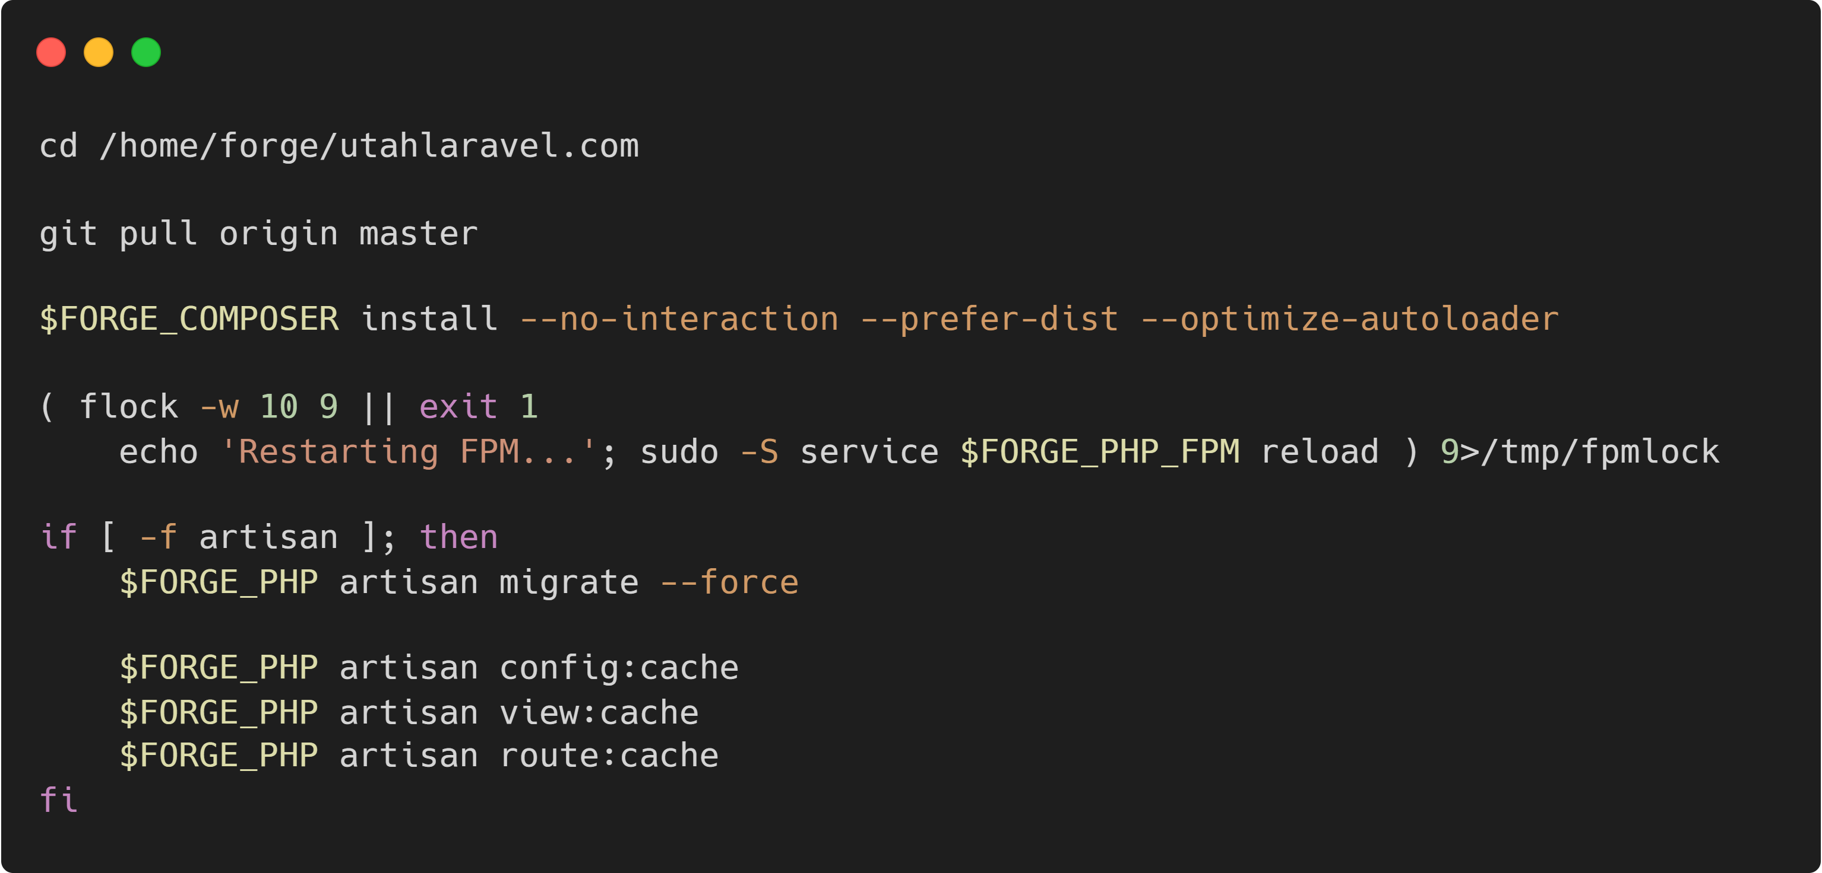
Route, view, and config caching
Use this in production. Add it to a deploy script.

Slide 17
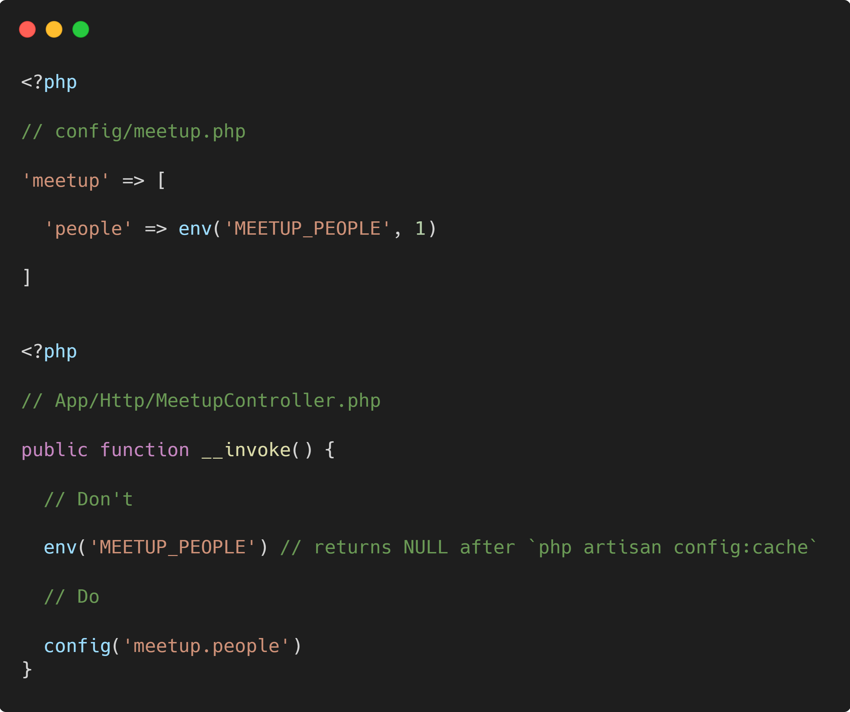
Cache Config gotcha

Slide 18
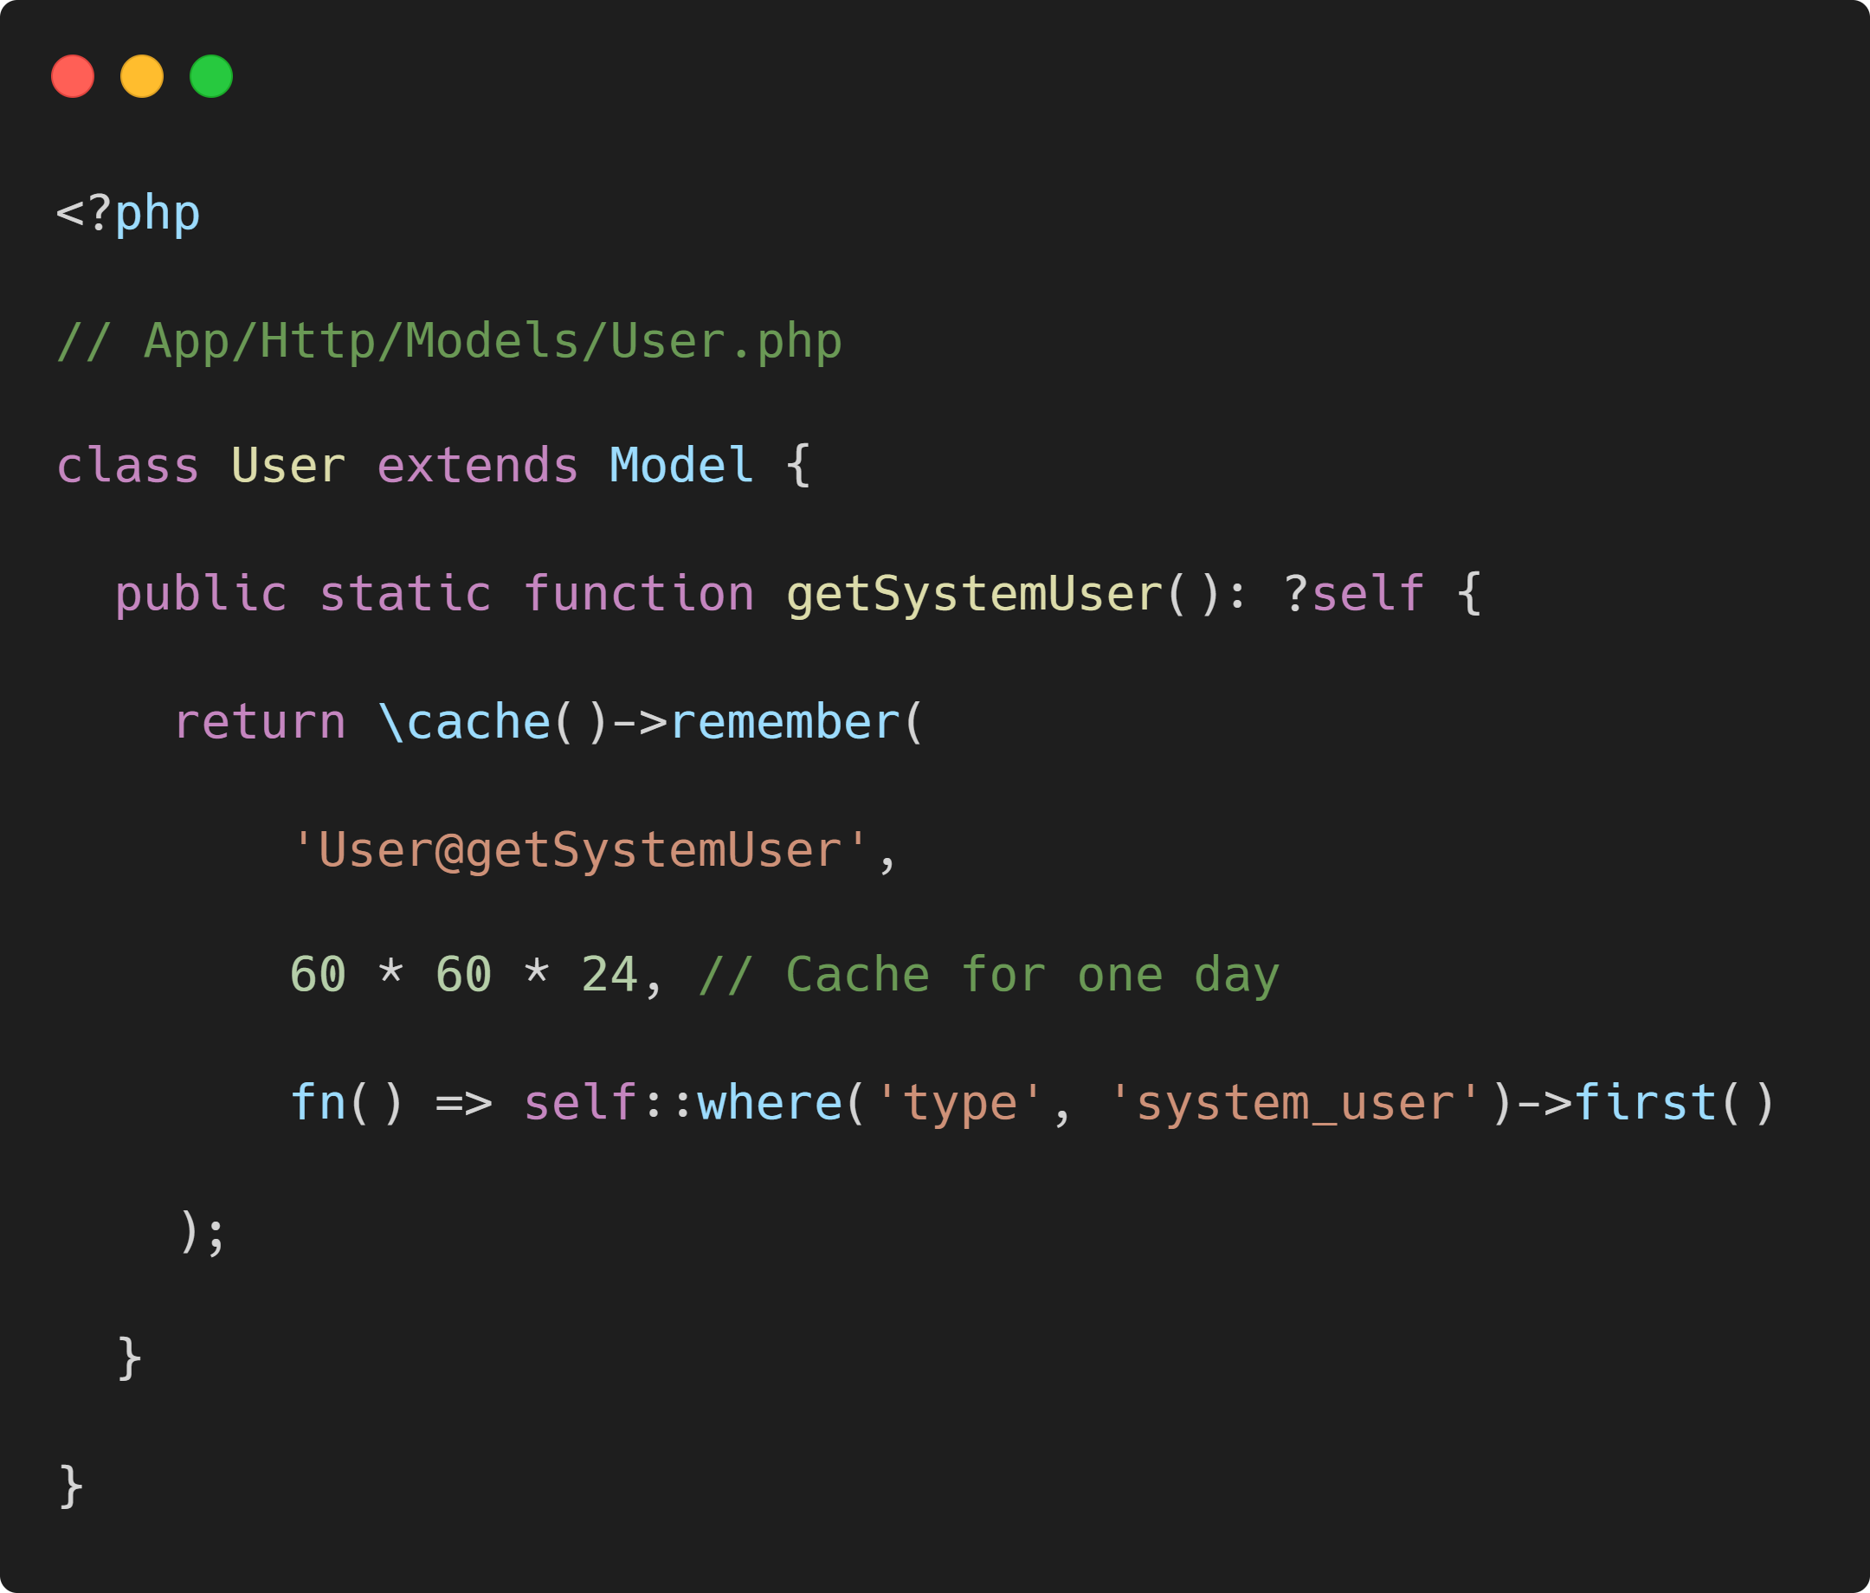
Cache Frequently Accessed models

Slide 19
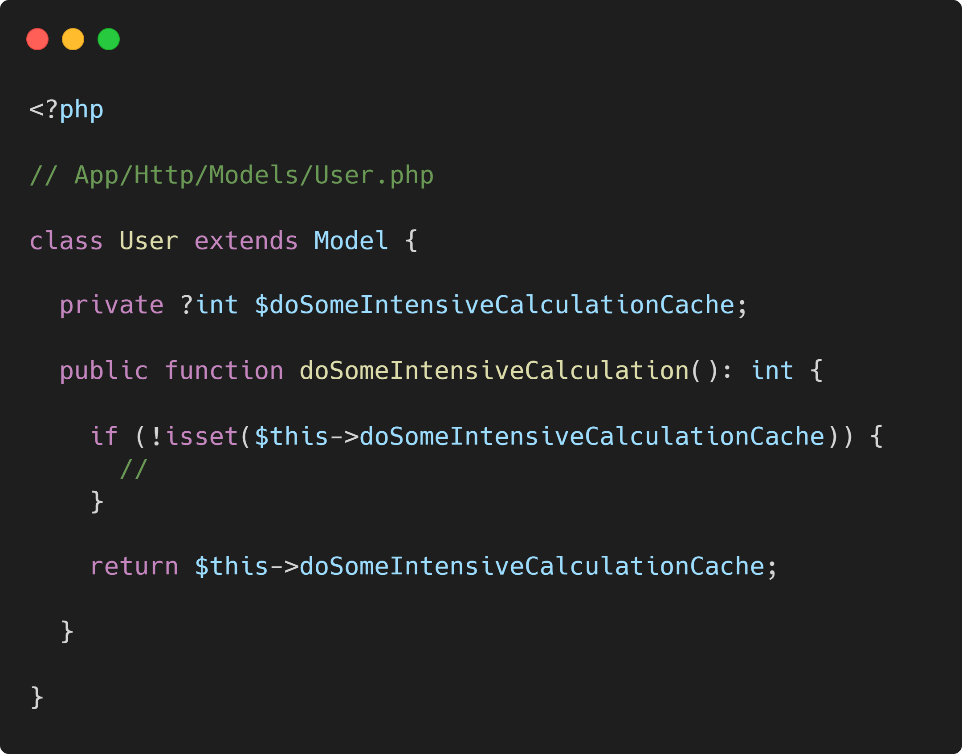
Keep expensive reused methods in memory

Slide 20
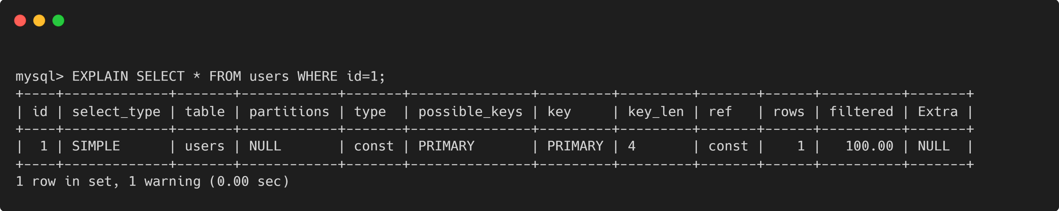
Sql Indices
Primary keys are always indexed
Consider indexing commonly-queried columns
Use EXPLAIN to see if keys are being used in more complex situations
Notes:
Check out the key column here.
Primary columns are indexed by default. For commonly-queried columns, consider using an index to speed things up.

Slide 21
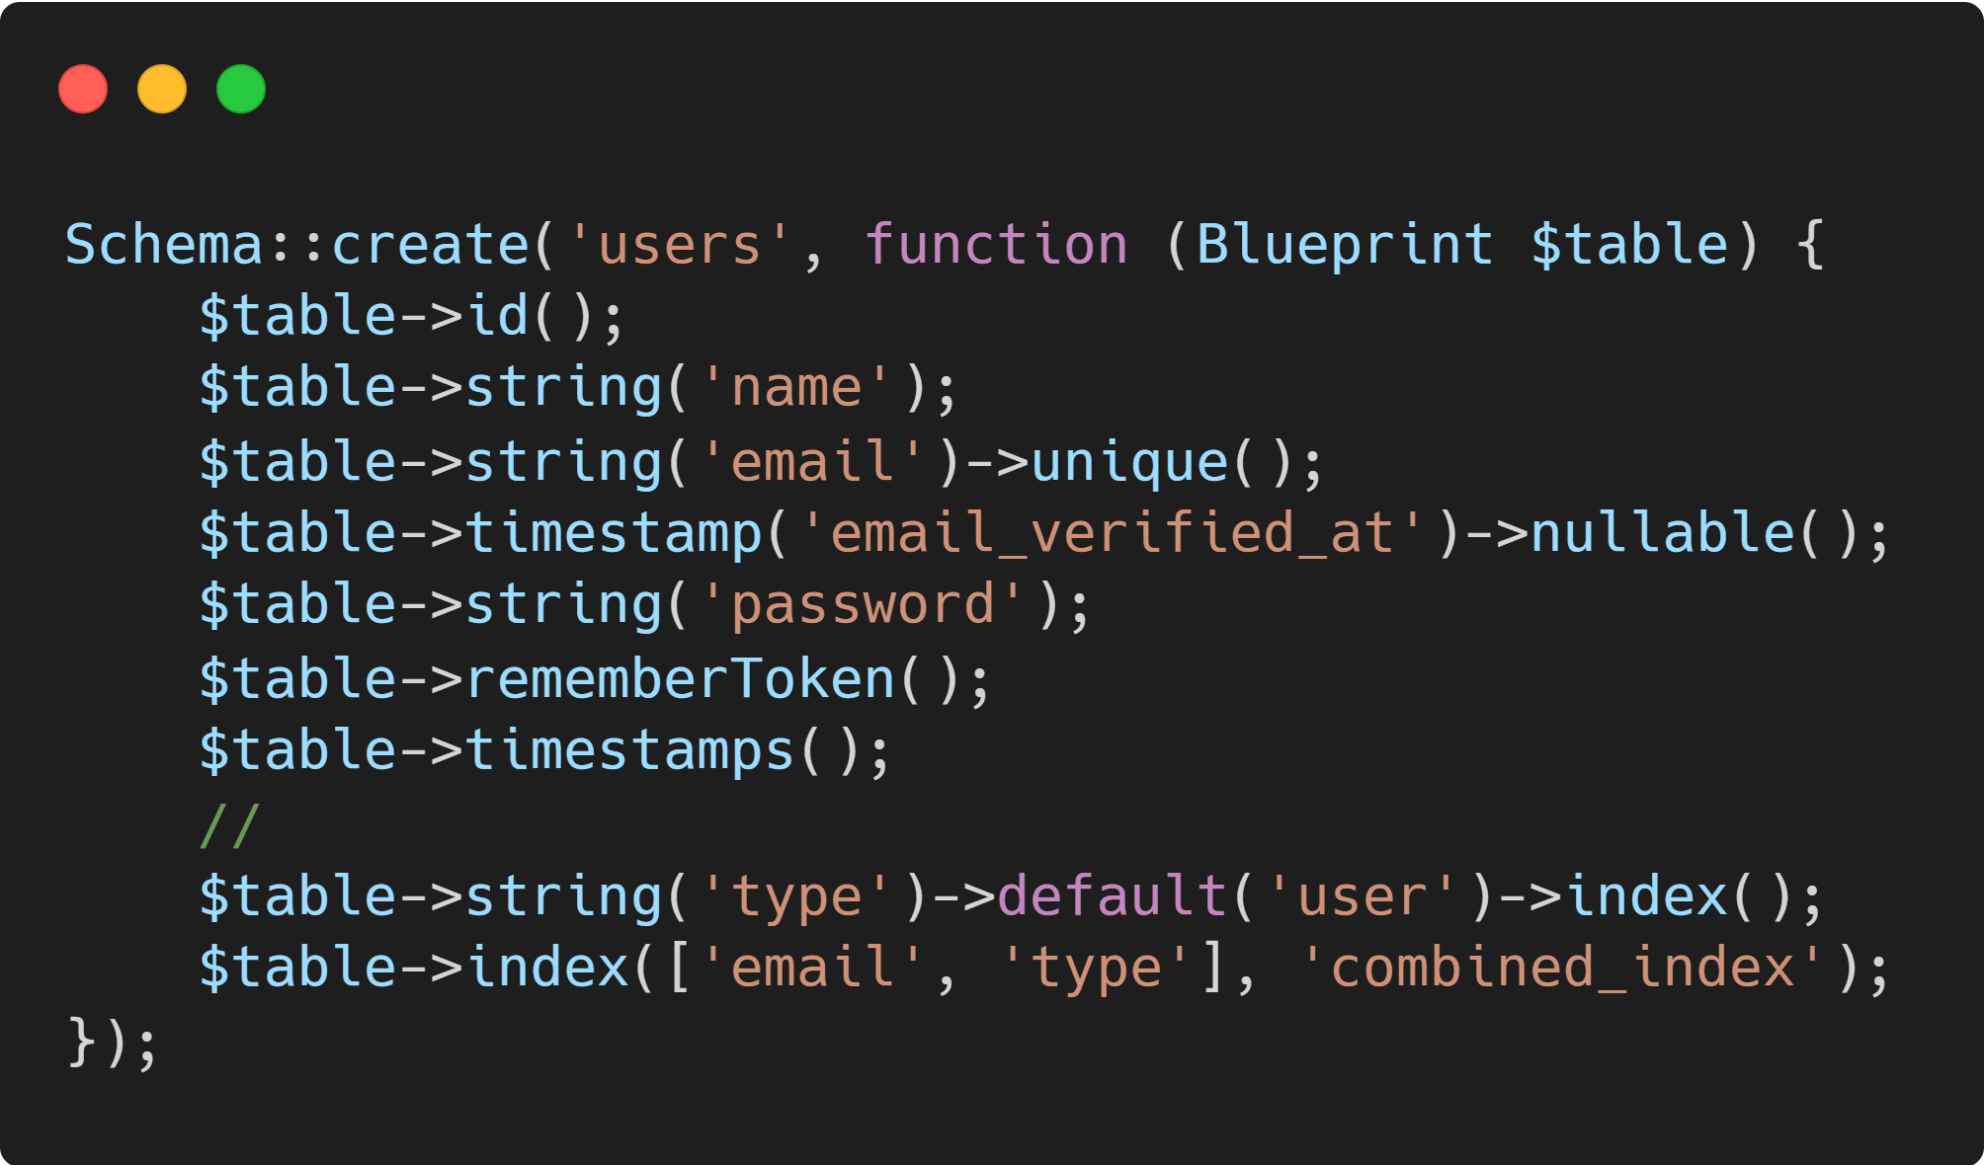
Advanced: Combined Indices
You probably won’t use these as often
Order of indexed columns matters. If you index column1, column2, and column3, all of the following queries will benefit: SELECT * FROM users WHERE column1 = `foo` SELECT * FROM users WHERE column1 = `foo` AND column2 = `bar` SELECT * FROM users WHERE column1 = `foo` AND column2 = `bar` AND column3 = `baz`
Sample Laravel syntax:

Slide 22
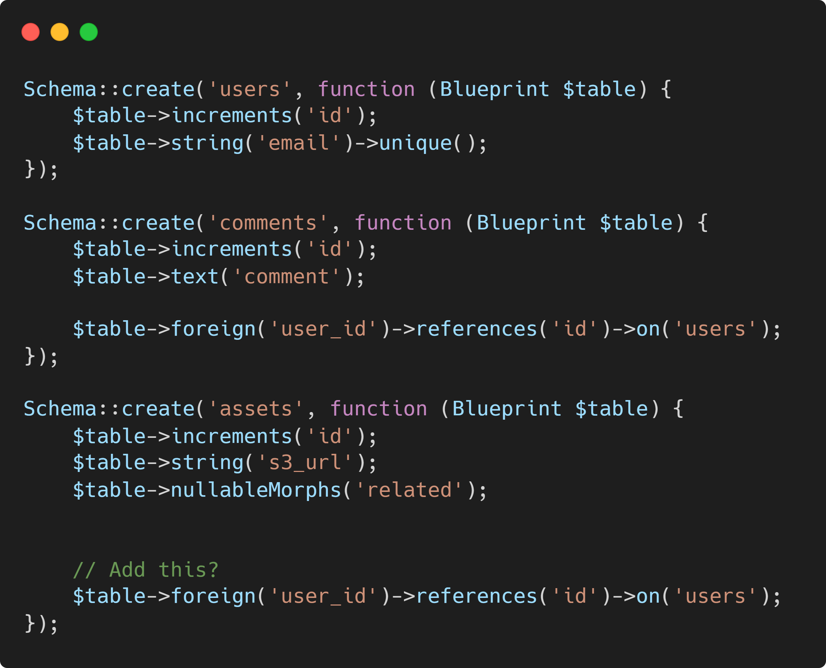
Make your data work for you
Laravel relationships makes it easy to oversimplify data
If you’re dealing with large amounts of data, it may be more efficient to duplicate data across multiple tables than to rely on relationships

Slide 23

Putting it all together
Notes:
Now we’re going to make every service work with the other.

Slide 24
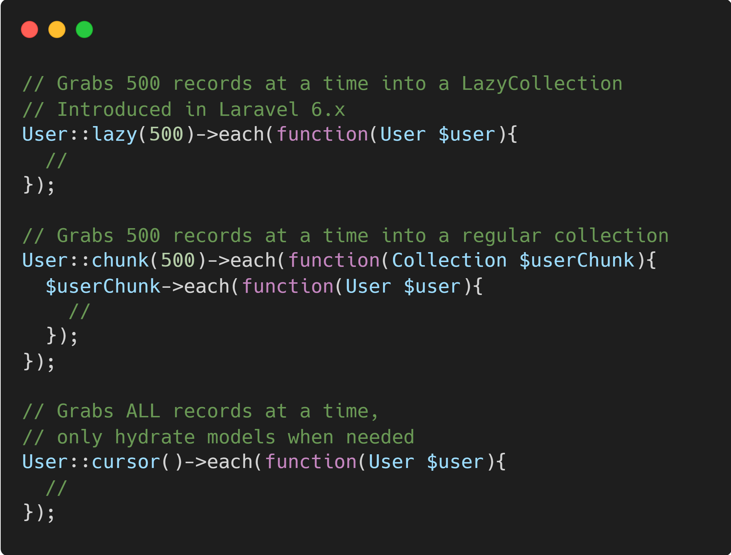
Lazy, cursor, & chunks
Memory usage slows down PHP a LOT. Here are a few methods you can use.
Notes:
::chunk() and ::lazy() overlap.
::lazy() is more concise.
You’ll probably reach for ::cursor() most often to combine the least SQL queries with a tiny PHP memory footprint.

Slide 25
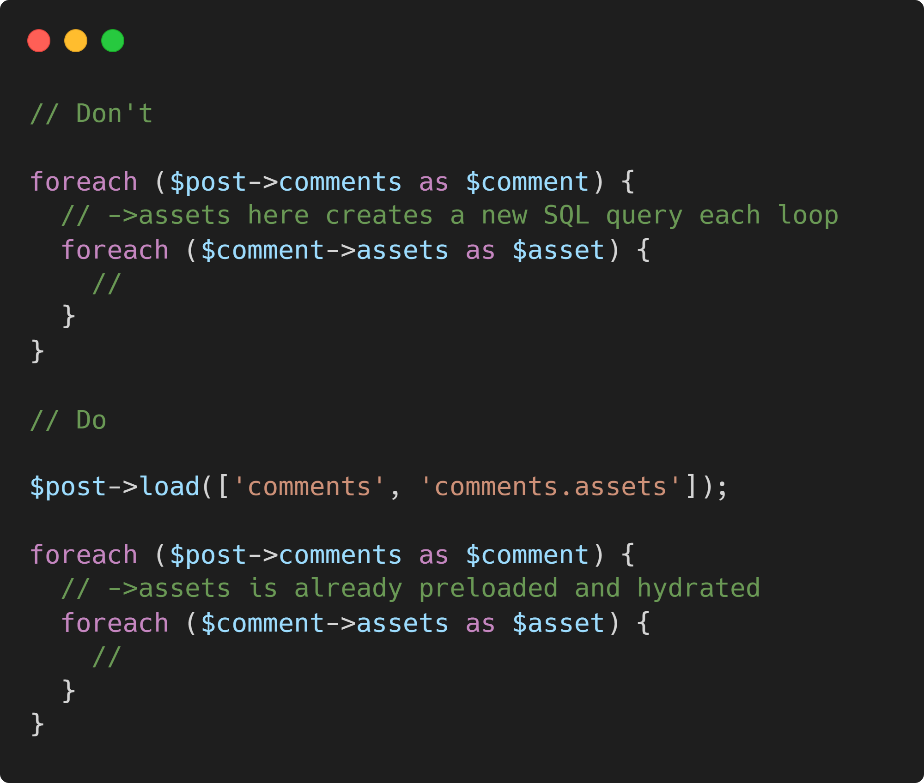
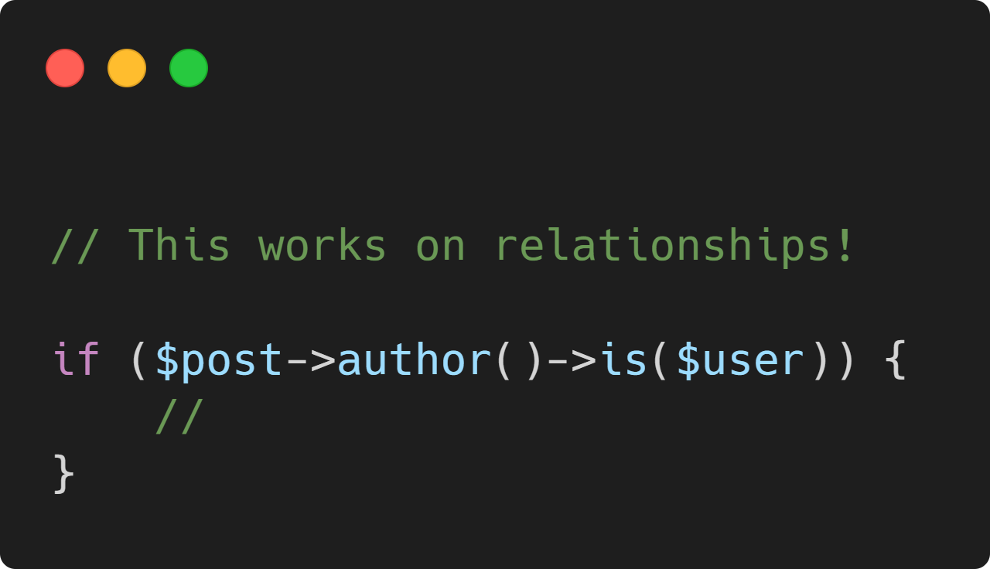
Eager Load relationships

Slide 26
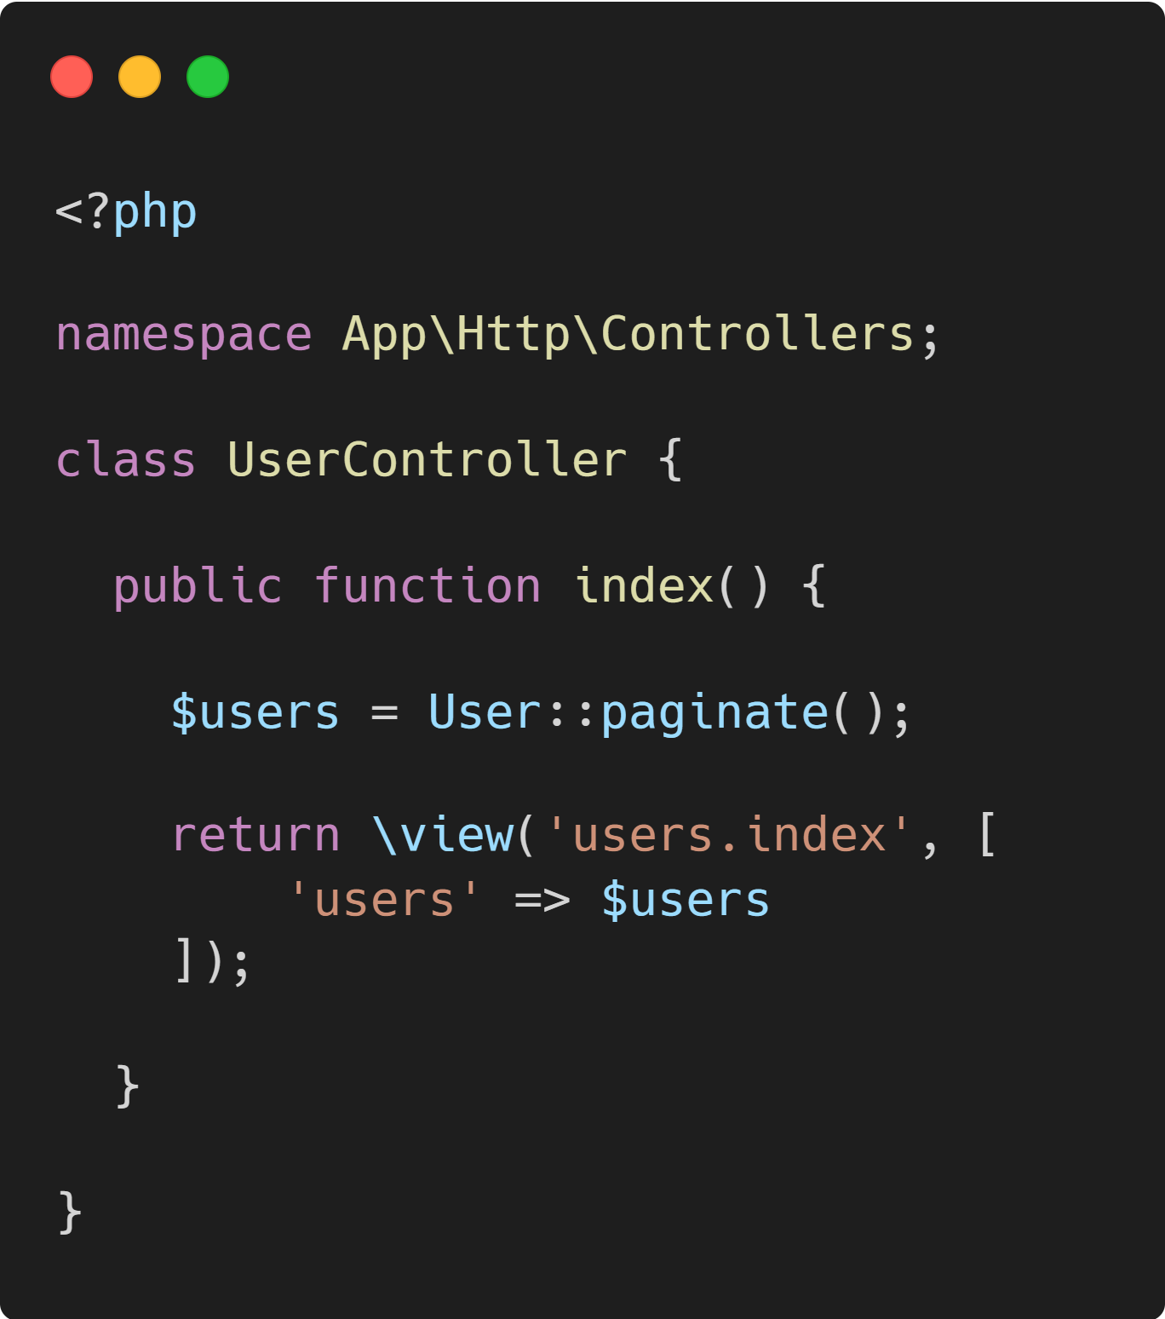
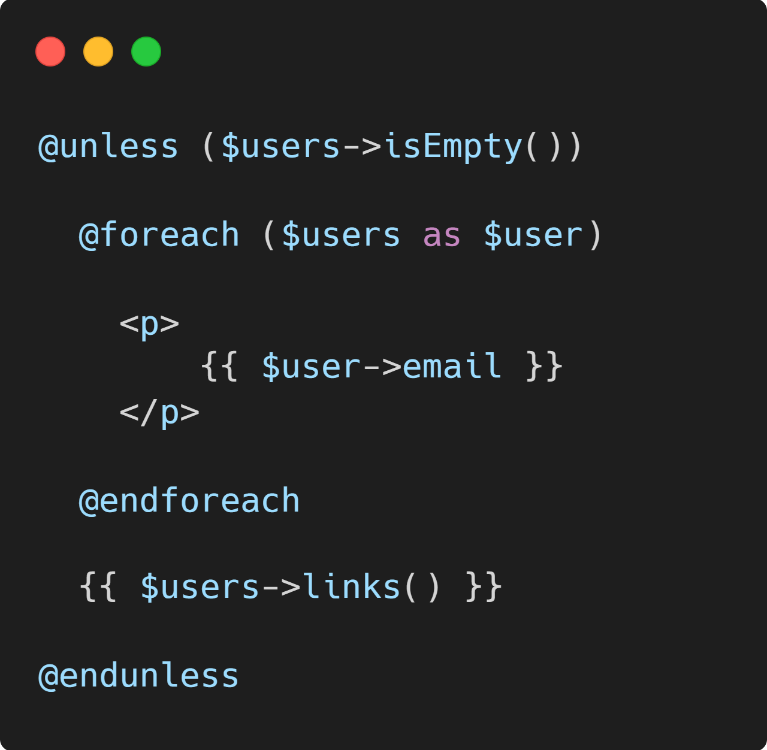
Pagination
Notes:
This one’s free. Limit the things.

Slide 27
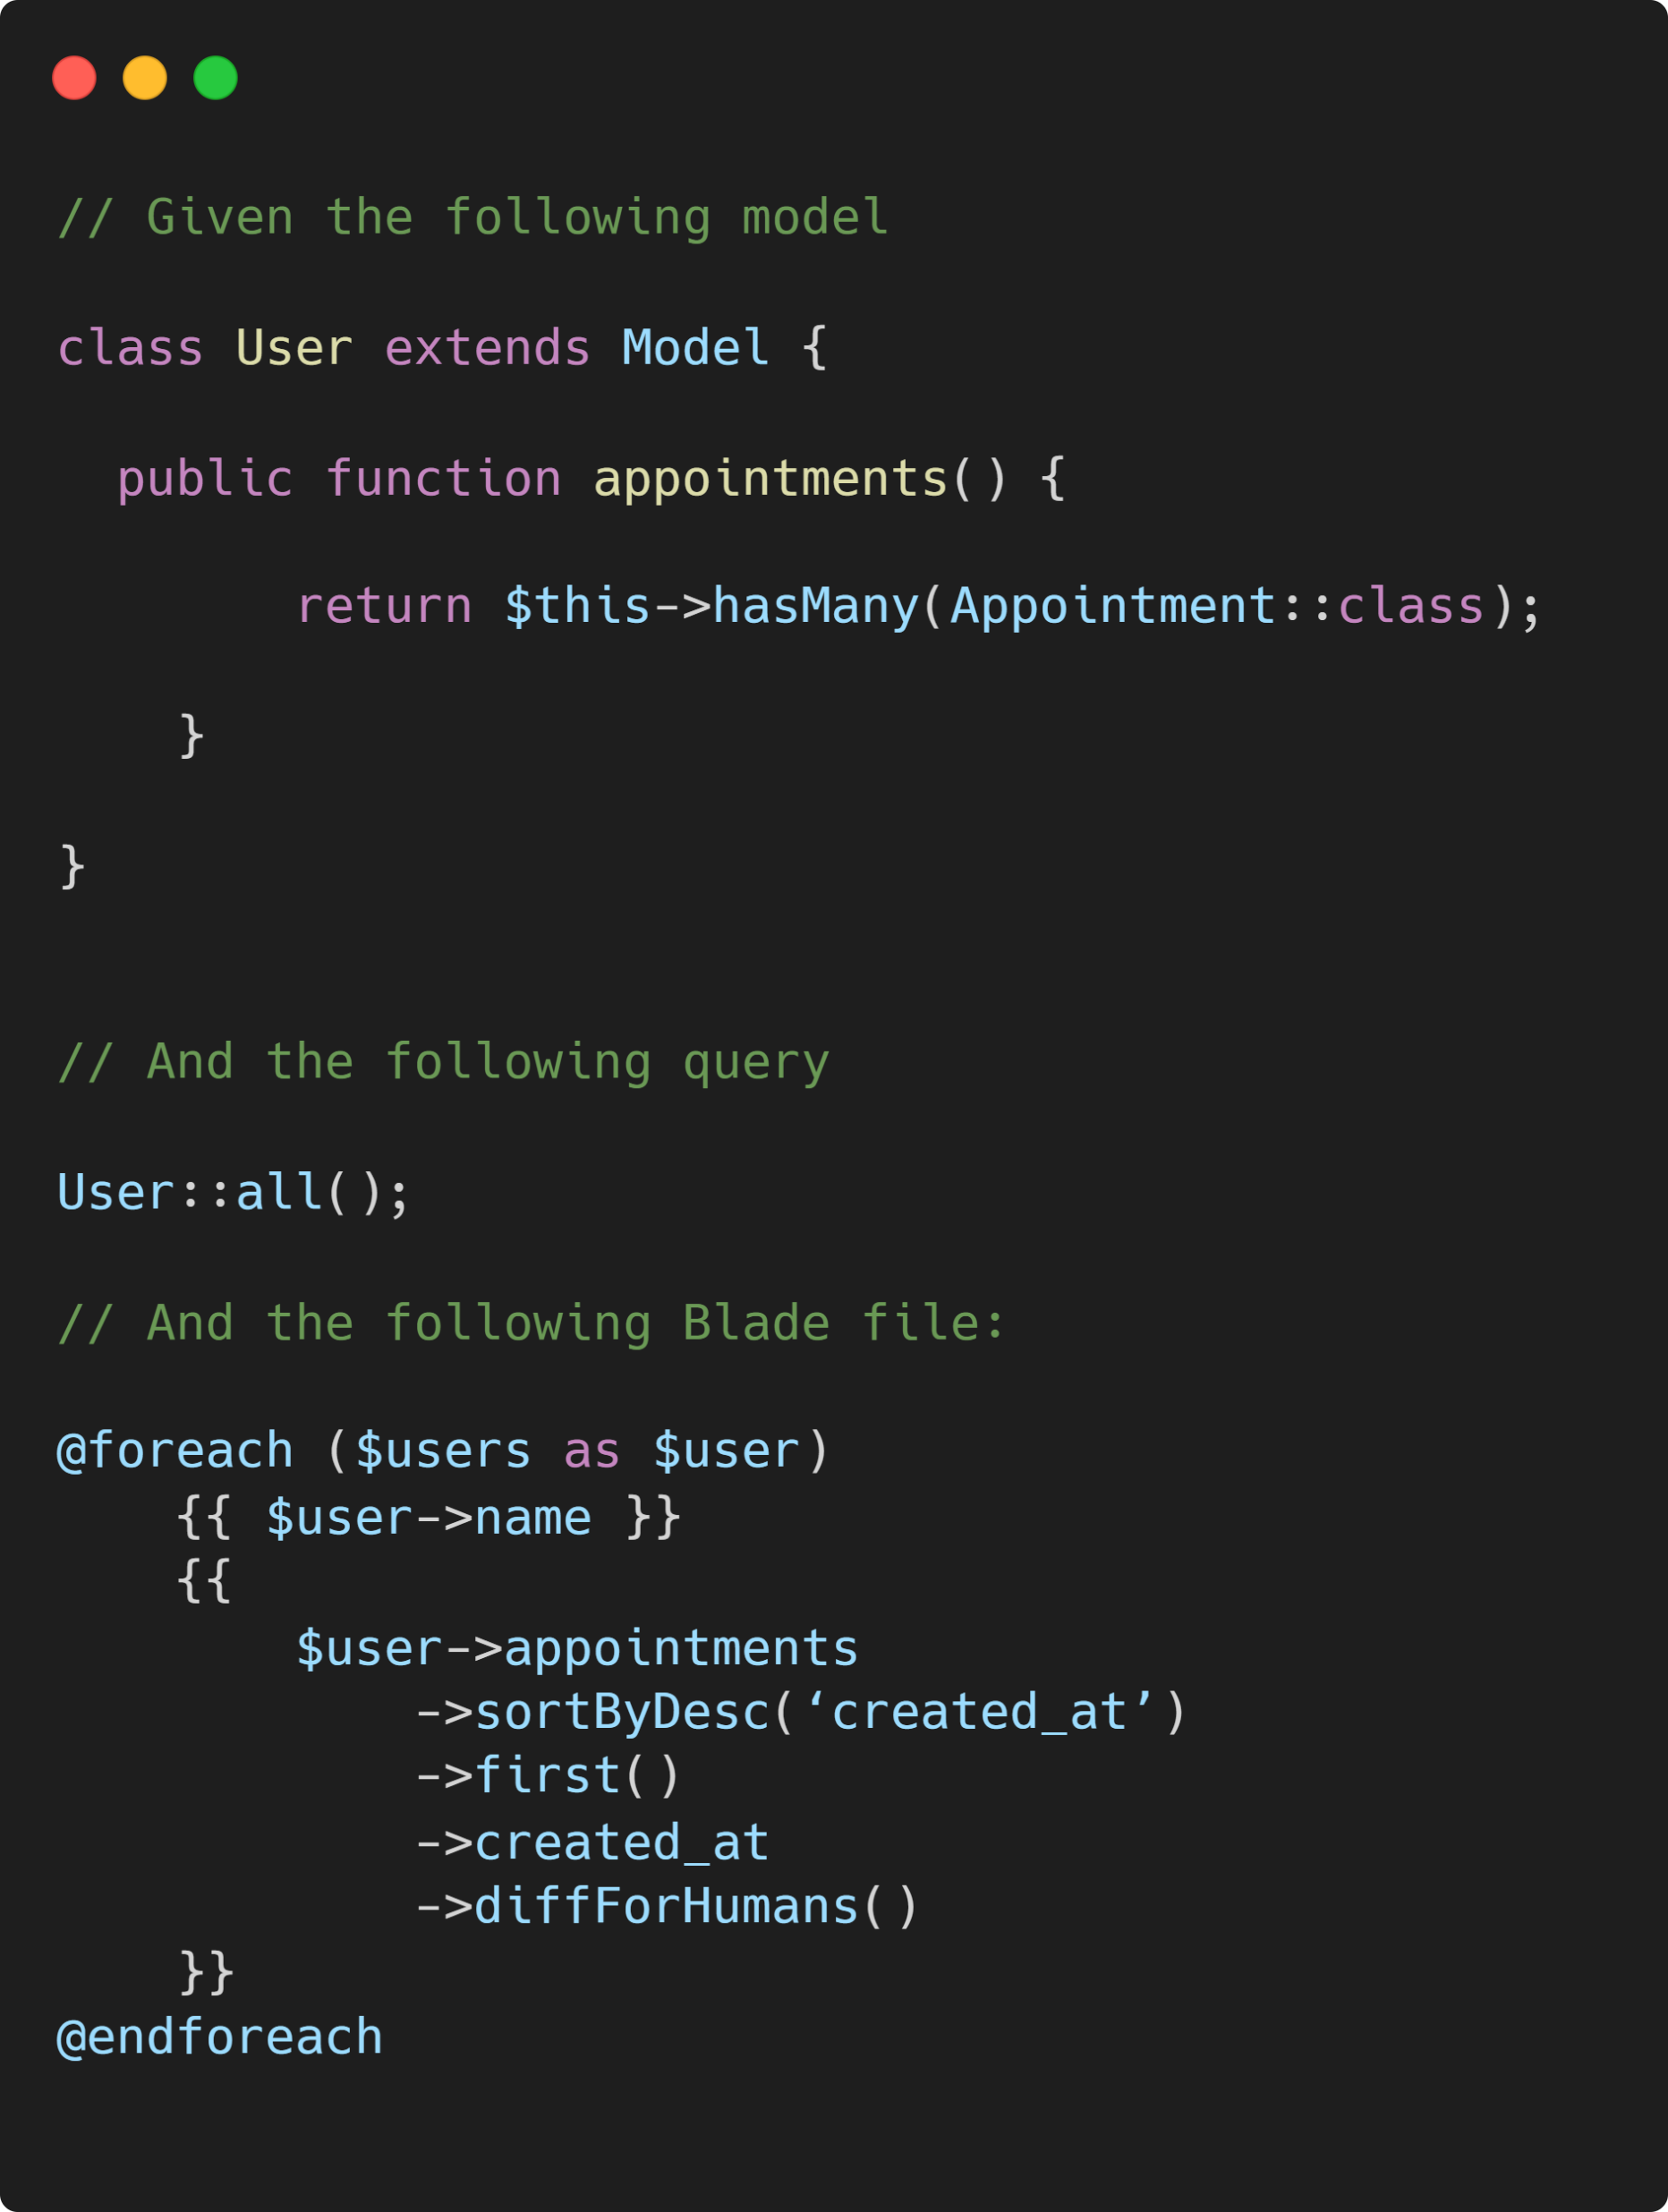
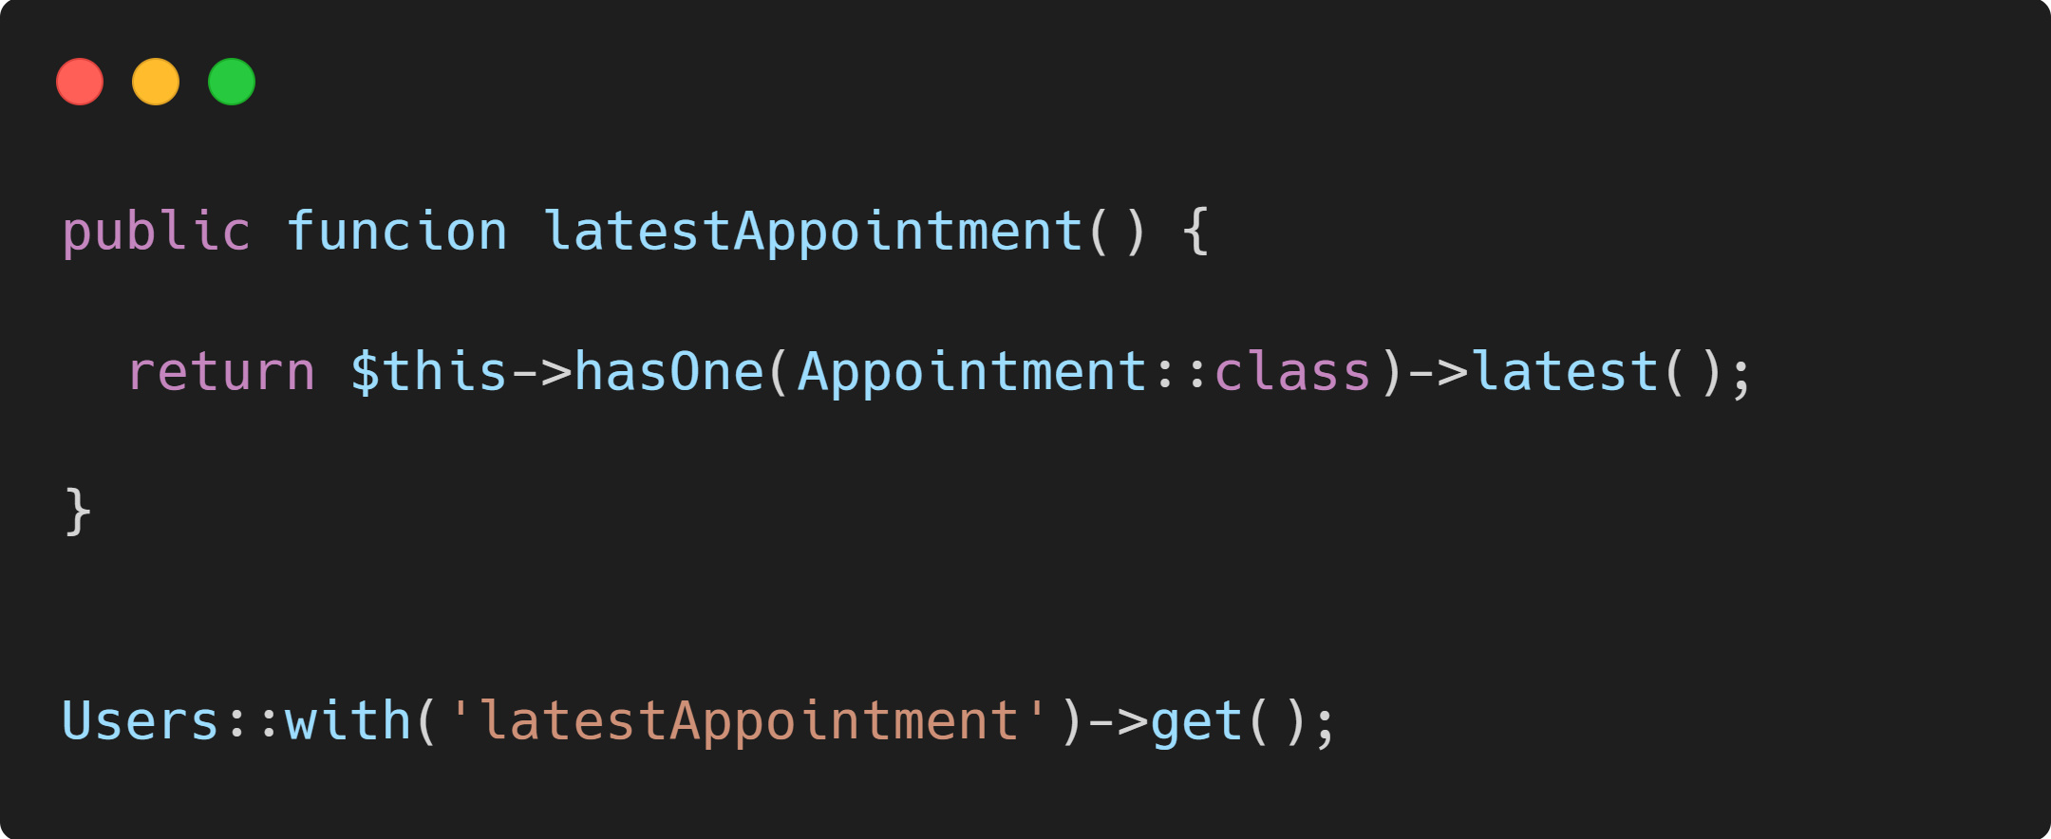
Pitfalls:
->appointments causes a fresh database round trip at each iteration
->sortByDesc is happening on a collection where we could’ve used the query builder
Easy solution:
Case Study

Slide 28
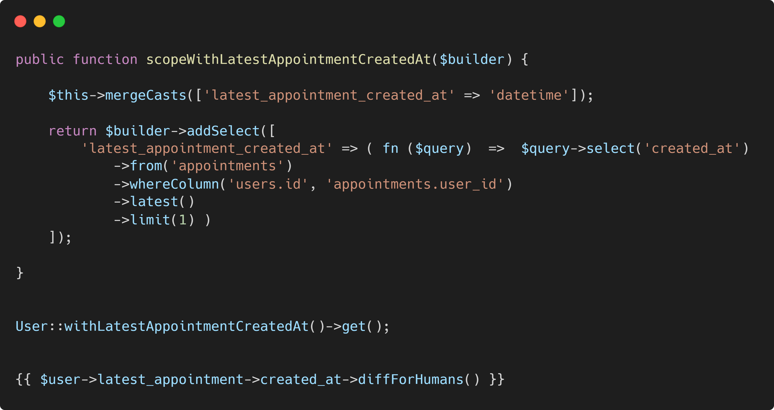
Advanced: only load exactly what you need

Slide 29

Final Thoughts

Slide 30

Performance Pitfalls 📛
→ sheng@diglactic.com
 @ShengSlogar
 sheng.dev
 @sheng on slack.utahlaravel.com

